Slide 1
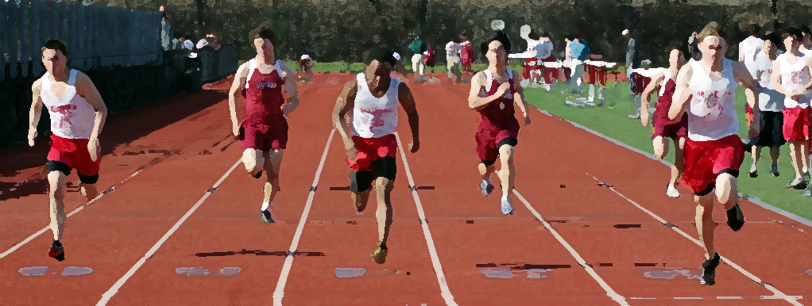



Student Athletes
[ YOUR LOGO HERE]
Prescription Opioid
Misuse Prevention

Slide 2
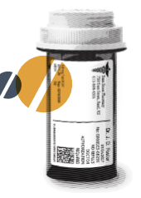
WHAT ARE Rx OPIOIDS?
Prescription pain killers that are powerful and addictive
Similar chemical properties and addictions risks as heroin
ex: Oxycodone (Oxycontin), Hydrocodone (Vicodin), Tylenol #3
RISKS?
Psychological dependence or addiction
Unintentional overdose
Serious side effects, such as sedation, nausea, or vomiting
Individuals stealing or accessing your prescribed medications

Slide 3
What is prescription medication abuse?
Use of any medication that is not prescribed to you
Taking too much of your prescribed medication or taking it too often
Using a medication for any reasons other than what the prescription states

Slide 4
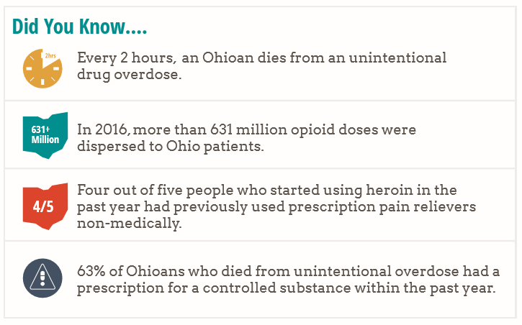
OHIO
STATS

Slide 5
Why are student athletes at risk?
2 million high school athletes will be injured this year
Many will be prescribed opioid painkillers
75% of high school heroin users started with prescription opioids
Increased access due to high rates of injury on teams and unsafe medication sharing
Culture of ‘play through the pain’

Slide 6

BE
THE
MAJORITY
85% of high school student have NOT misused prescription meds in the last year
88% of male athletes are NOT prescribed opioids
92% of female athletes are NOT prescribed opioids

Slide 7

DON’T LET AN INJURY LEAD TO AN OPIOID ADDICTION
You got injured…
Now what?

Slide 8

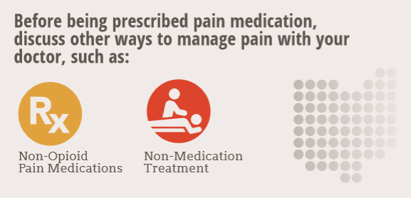
ACETOMINOPHEN
ANTI-INFLAMMATORIES
ICE, HEAT
PHYSIOTHERAPY
MASSAGE
ACCUPUNCTURE
NERVE STIMULATION
COMPRESSION
YOGA

Slide 9


AN INJURED ATHLETE NEEDS TIME TO HEAL
DON’T MEDICATE TO PLAY THROUGH PAIN
BREAK THE CYCLE OF INJURY, PAIN,
RE-INJURY

Slide 10

You are in charge of your own health
Know your options
Use alternatives
Ask your care provider questions before prescription
If an opioid is required, use it for the shortest time possible
Take time to heal but still stay involved with the team

Slide 11
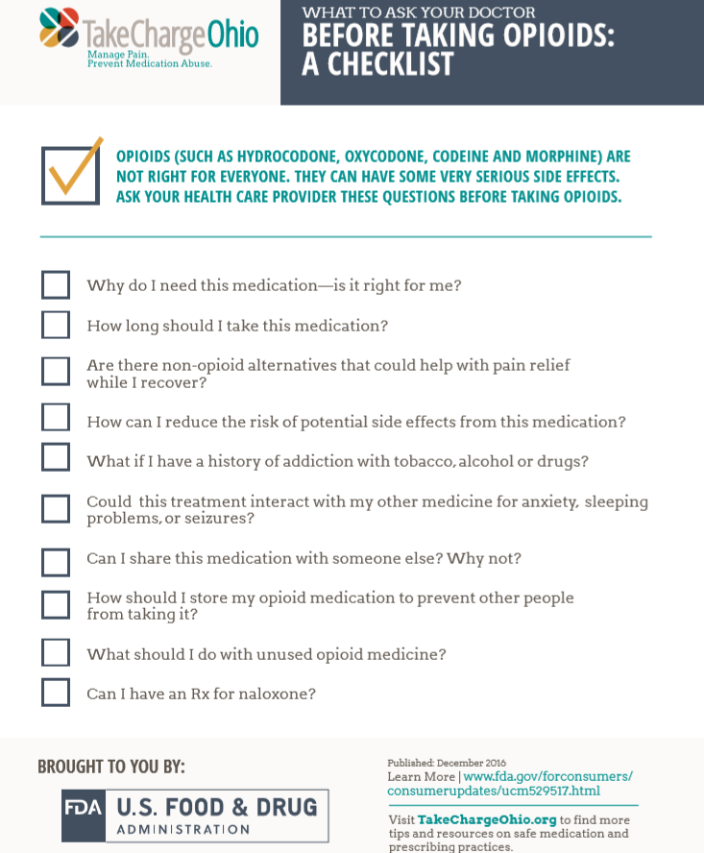
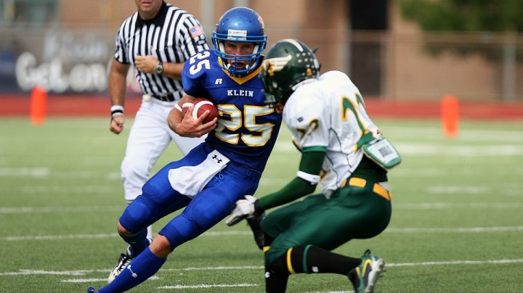
ASK QUESTIONS
BE ENGAGED
TAKE CHARGE

Slide 12






Safe Medication Practices
Only use prescription medications as directed by your healthcare professional
Do NOT share your meds, or take someone else's
Keep your meds safe, and out of someone else’s hands
Model safe medication practices

Slide 13
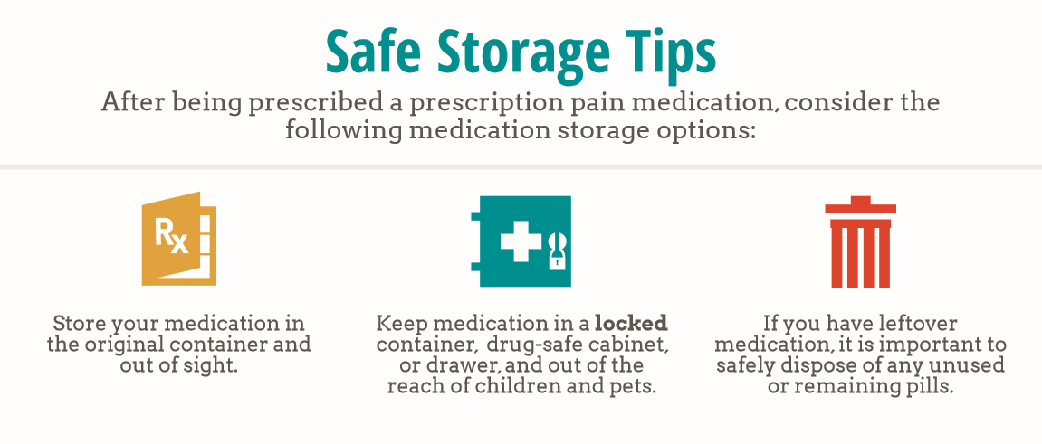


Slide 14
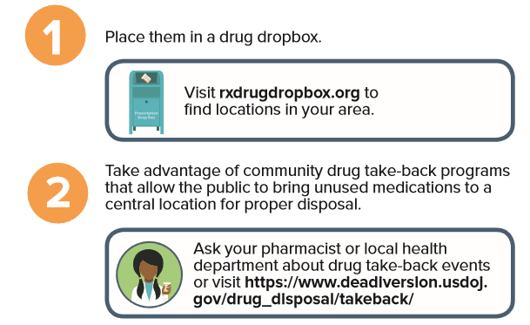
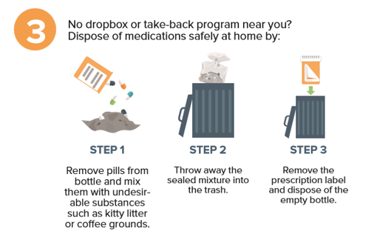
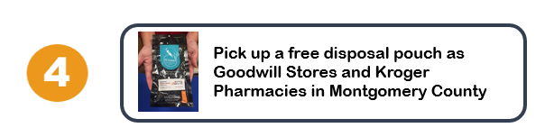

Safe Medication Disposal Options

Slide 15

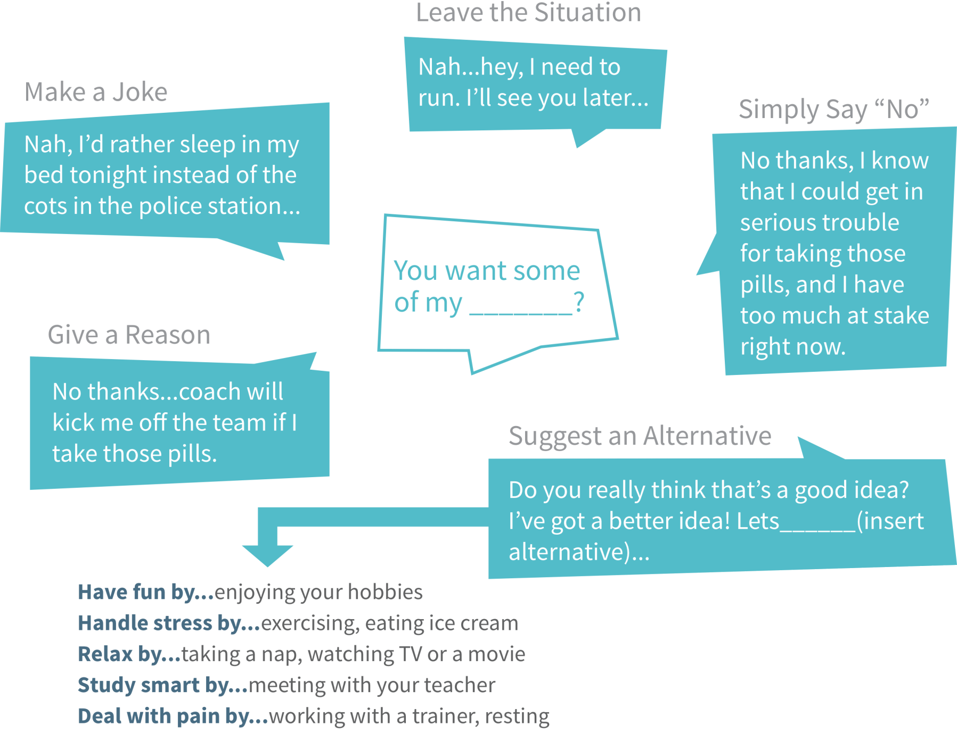

How to say
‘NO’

Slide 16
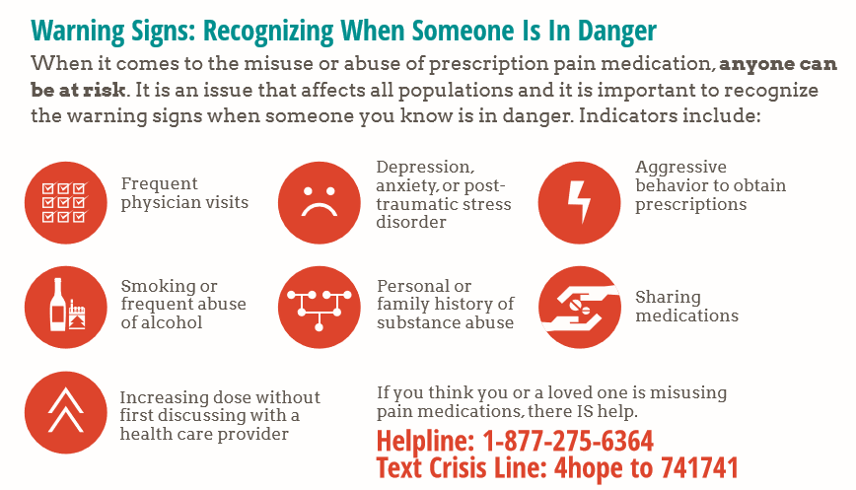

CHECK YOURSELF AND YOUR TEAM MATES

Slide 17

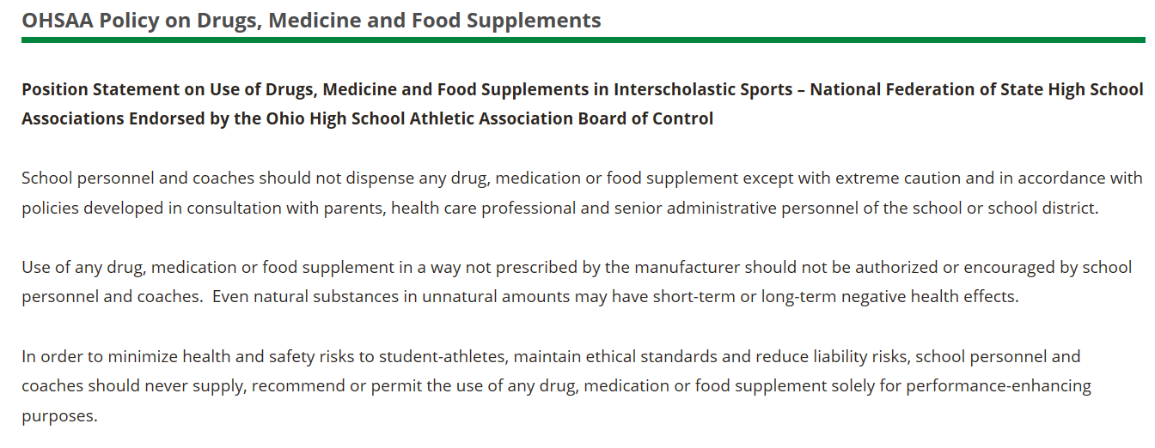
OHSAA Policy on Drugs, Medicine and Food Supplements

Slide 18






RESOURCES
generationrx.org
takechargeohio.org
drugfree.org

